Slide 1
WIND ENERGY

Slide 2
INTRODUCTION
Energy is a major input for overall socio-economic development of any society
The prices of the fossil fuels steeply increasing
So renewables are expected to play a key role
Wind energy is the fastest growing renewable
Wind turbines are up to the task of producing serious amounts of electricity

Slide 3
"Coal, gas and oil will not be the three king of the energy world for ever. It is no longer folly to look up to the sun and wind, down into the sea's waves"
A Great Scientist once said:

Slide 4
WIND POWER
All renewable energy (except tidal and geothermal power), ultimately comes from the sun.
An estimated 1% to 3% of energy from the Sun that hits the earth is converted into wind energy.
The principle of wind is simple. The poles recieve less energy than the equater does from the sun. Also land heats up and cools down more quickly than the seas. This difference between the seas and the land causes a global atmospheric convection system.

Slide 5
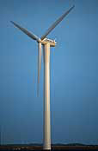
WIND ENERGY CONVERSION
The conversion of
Wind Energy to
Electricity
is primarily done
using a WIND TURBINE.

Slide 6
COMPONENTS OF THE WIND TURBINE

Slide 7
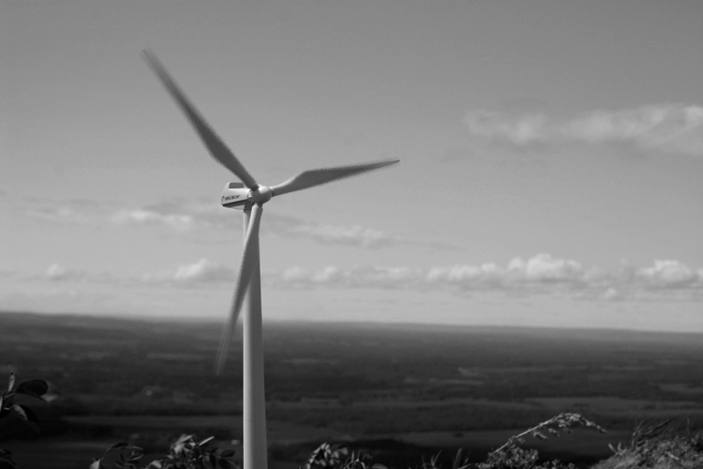
THE PRINCIPLE OF A WIND TURBINE
The wind power can be gained by making it blow past the blades that will cause the rotor to twist. The amount of power transferred is directly proportional to the density of the air, the area swept out by the rotor, and the cube of the wind speed. It can be found out by the following equation:
Where: ρ =Wind density, R= Rotor Radius, v =Wind speed

Slide 8
WIND ENERGY CONVERSION DIAGRAM

Slide 9
ADVANTAGES OF WIND POWER
The wind blows day and night, which allows windmills to produce electricity throughout the day. (Faster during the day)
Wind energy is a domestic, renewable source of energy that generates no pollution and has little environmental impact. Up to 95 percent of land used for wind farms can also be used for other profitable activities including ranching, farming and forestry.
When the turbines become unusable they can be disposed easily and the area left behind can be reused.
The decreasing cost of wind power and the growing interest in renewable energy sources should ensure that wind power will become a viable energy source in the United States and worldwide.

Slide 10
THANKS FOR YOUR PATIENCE

