Slide 2
LIVING GREEN

Slide 3
Outline
Environmental Problems
Causes of Environmental Problems
Living green
Sustainable Development
Components of Living Green
Implementing Living green in our lives
Benefits of Living green

Slide 4
Environmental Problems.
Global Warming.
Environmental Degradation.
Ozone layer Depletion.
Pollution.
Overcrowding.

Slide 5
Causes of environmental problems
Climate change.
Deforestation.
Desertification.
Increased natural disasters.
Loss of biodiversity.
Exploitation/Degradation of Natural Resources.
Unequal distribution of resources.
Urbanization.
Changes in Technology/Industrialization.
Cultural Changes.
Modern Agriculture.

Slide 6
LIVING GREEN
Living green is a “lifestyle which seeks to bring into balance the conservation and preservation of the earth’s natural resources, habitats and biodiversity with human cultures and communities.”
Living green, which means sustainable lifestyle, can ensure preventing the earth from being threatened and better life for our next generations.
Green lifestyle involves making sustainable choices about what we eat, how we travel, what we buy, and how we use and dispose it.

Slide 7
GOALS OF LIVING GREEN
Resource Efficiency
Energy
Water
Food
Biodiversity
Reduction of
Waste.
Pollution.
Environmental Degradation.
Health improvement
Protection from diseases
Better physical and Mental Health.

Slide 8
SUSTAINABLE DEVELOPMENT
Adopting sustainable development is the key to Livng Green!
Sustainable development has three dimensions:
“Sustainable development is development that
meets the need of the present without compromising
the ability of the future generations to meet their own needs.”
SOCIAL
ECONOMIC
ENVIRONMENTAL

Slide 9
COMPONENETS OF LIVING GREEN
Sustainable Agriculture
Green Energy
Green Construction
Green Travel
Green Consumption
These components help ensure social and economic development while conserving the environment and natural resources.

Slide 10
SUSTAINABLE AGICULTURE.
It is the production of food, fiber or other plant or animal products using farming techniques that protect the environment, public health, human communities and animal welfare.
Organic farming.
Poly culture/crop rotation.
Soil enrichment.
Nutrient Management.
Natural Pest predators.
Non-chemical/ Bio-intensive integrated pest management.

Slide 11
GREEN ENERGY
We need to move from the dependence of fossil fuels towards the sustainable energy sources like:
Solar power
Wind Power
Hydro Power
Geothermal Power
Tidal Power
Power from Biomass
Biofuels.

Slide 12
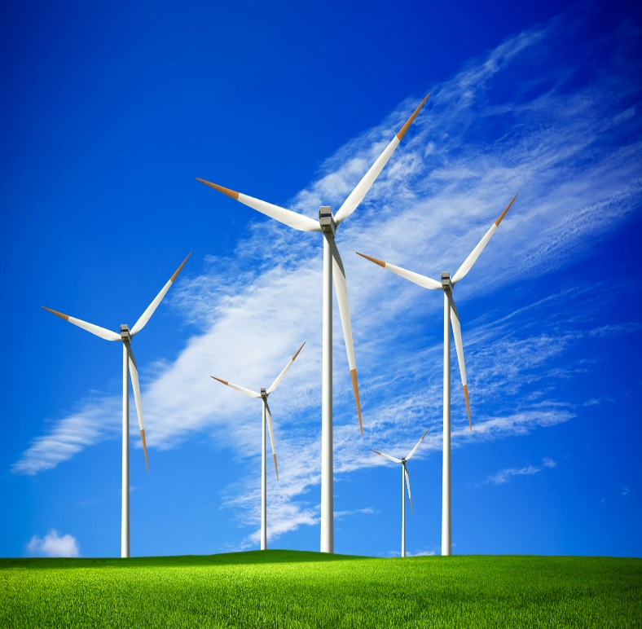
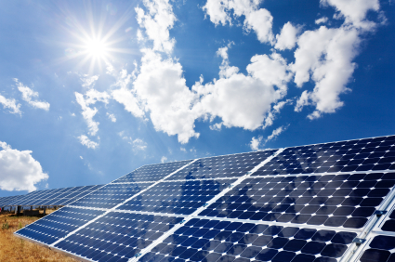
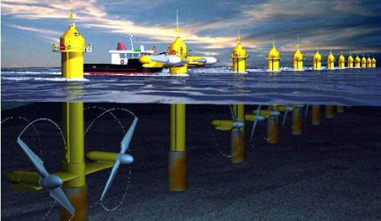
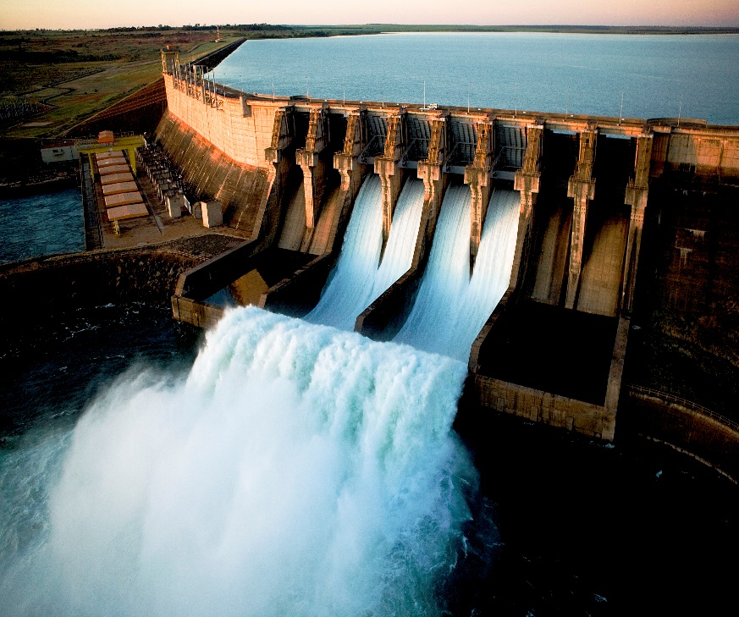
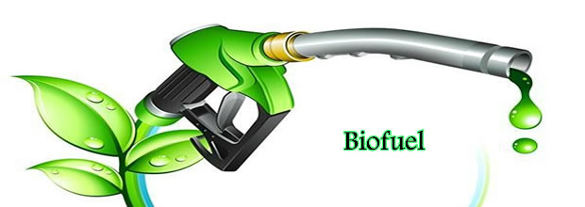

Slide 13
Green construction
Green Building: LED- optimizing the use of natural light, Water conservation- water management and rain water harvesting, otimizing natural heat-solar panels, materials-use low impact products, waste- reduce, re-use, recycle, Biodiversity- reducing impact on biodiversity, sanitation- eco friendly sanitation.
Green Sanitation: Clean drinking water, waste water disposal, Clean toilet, human and animal waste disposal, House and food hygiene, personal hygiene, Cleanliness of the surrounding.

Slide 14
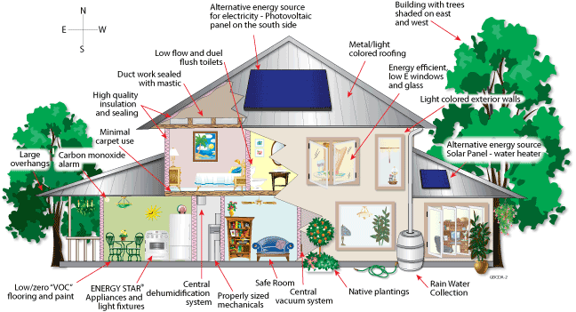
A green building:
Operates energy efficiently.
Conserves water.
Is comfortable, safe and healthy.
Is durable and maintainable with minimal environmental impact.

Slide 15
Green consumption
Green Consumption is the regular practice of consuming products that do not harm human health and do not affect the environment adversely.
How to implement green consumption in our lives:
Purchase food from the local market.
Avoid excessive package
Reduce the use of plastic bags
Look for products with green label.

Slide 16
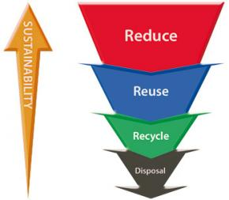
Implementing living green in our lives
3R’S: Reduce, Reuse and Recycle.
Save Energy.
Save Water.
Eat Green.
Plant Green.

Slide 17
BENEFITS OF LIVING GREEN
Reduces Pollution.
Reduces Carbon Print.
Increases availability of fresh water.
Saves energy – decreases the demand for fossil fuels.
Gives Healthier lives.

Slide 18
Remember!
Earth provides enough to satisfy every man’s need but not every man’s greed.- Mahatma Gandhi.
Green club
Lets go green

