Slide 1
SUCCESSFUL ENTREPRENEURS GOING GREEN
CASE STUDY: ELON MUSK

Slide 2
AIMS AND OBJECTIVES
To talk about successful entrepreneurs like Elon Musk.
To learn about his interest in sustainability and the successful business he has around it.
To show that you can be successful and still protect the environment.

Slide 3
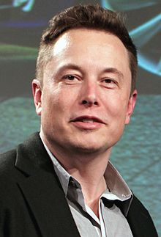
INTRODUCTION
Notes:
THE FOUNDER

Slide 4
ABOUT ELON MUSK
Musk is known for his prowess as a business leader.
In 2016, Musk was ranked 21st on Forbes list of The World's Most Powerful People.
In 2017, he has an estimated net worth of $15.2 billion, making him the 80th-wealthiest person in the world.
Musk determined three main things that were likely to change the world in his lifetime: the internet, renewable energy and space travel. Hence his businesses were centered on these three things.

Slide 5
HIS BUSINESS
ZIP2: A web software company.
X.COM AND PAYPAL: An online financial services and e-mail payment company.
HYPERLOOP: A concept for a high-speed transportation system.
NEURAL LINK: The company is centered on creating devices that can be implanted in the human brain, with the eventual purpose of helping human beings merge with software and keep pace with advancements in artificial intelligence.

Slide 6
5. SOLAR CITY:
The underlying motivation for funding solarcity is to help combat global warming. SolarCity involves the replacement of dirty energy with clean energy, spelling the end of the coal- and natural-gas-burning power plants to a large extent.

Slide 7
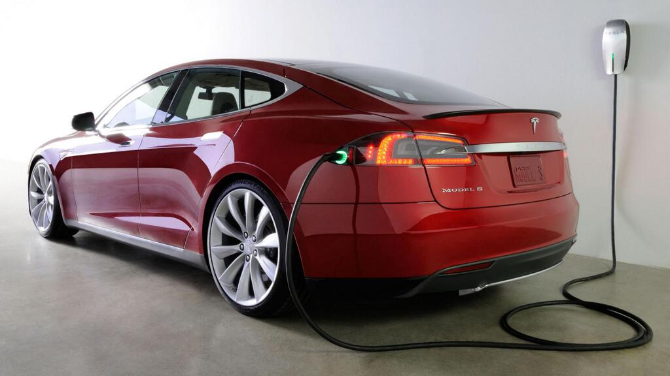
6. TESLA: Tesla Motors built an electric sports car (vehicles that don’t burn hydrocarbon i.e zero emission vehicles).

Slide 8
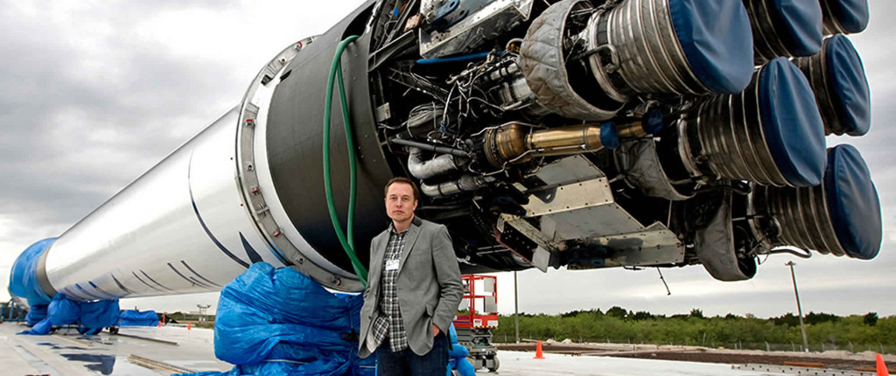
7. SPACE X:
Musk was influenced by Isaac Asimov's Foundation series and views space exploration as an important step in preserving and expanding the consciousness of human life. Musk said that multi-planetary life may serve as a hedge against threats to the survival of the human species.

Slide 9
ELON MUSK’S VIEW ON GOING GREEN
In order to ensure healthy air and a stable climate, we must reduce our dependence on the fossil fuels that currently dominate our electricity system. This system threatens the health of our communities by polluting the air and contributing to global warming.
Musk said changes in Earth’s temperature could lead to depleted water and food supplies, thus forcing millions of people to leave their homes in search of resources .

Slide 10
ELON MUSK’S VIEW ON GOING GREEN
During a presentation at the Paris-Sorbonne University in Paris, Musk said the adoption of sustainable energy over fossil fuels is ultimately inevitable because eventually humans will run out of fossil fuels.
Even if producing CO2 was good for the environment, given that we are going to run out of hydrocarbons, we need to find some sustainable means.

Slide 11
ELON MUSK’S VIEW ON GOING GREEN
However, he said one of two things will happen if governments continue to rely on fossil fuels.
“If we wait and delay the change, the best case is simply delaying the inevitable transition to sustainable energy. This is the best case if we don’t take action now”
“The worst case, however, is more displacement and destruction than all the wars in history combined.

Slide 12
ELON MUSK’S VIEW ON GOING GREEN
Practical solutions do exist, a policy that requires electricity suppliers to gradually increase their use of renewable energy such as wind, solar, geothermal, and bioenergy.
If governments propose a carbon tax(i.e paying for the carbon you emit), there’s a chance that the damage from climate change can be contained.

Slide 13
CONCLUSION
Elon Musk is a very wealthy and successful man, yet he is interested in the wellbeing of our environment.
Some people don’t like change but you need to embrace change if the alternative is disaster.
We must strive to develop things which are beneficial to our schools, home and the society at large. LETS GO GREEN.

