Slide 2
Who Are We?
We are a group of people passionate about our environment.
MISSION
Green club is on a mission to make our environment cleaner and safer for all to enjoy by raising awareness of how to properly take care of our planet.

Slide 3
AIM
Motivate students to value their environment.
Encourage students to assume responsibility of their environment.
Encourage positive peer influence .
Strengthen collaboration among students .
Develop life skills ( communication, interpersonal relationship, decision making, critical thinking, and self management) .

Slide 4
OBJECTIVES
Educating the students on what it means to go green theoretically and practically through various lectures on:
The Environment.
Recycling
Waste management
Agriculture
Green crafts
Green projects.

Slide 5
WHY ARE SCHOOLS OUR TARGET?
Being environmentally conscious is something that deserves more than simply a day or a week in the school year. Neither is it just a lesson, but rather a way of life that needs to be taught to children of future generations, particularly on how they can take care of the environment.

Slide 6
WHAT DOES GOING GREEN MEAN?
Basically, going green means to live life, as an individual as well as a community, in a way that is friendly to the natural environment and is sustainable for the earth.
It also means taking steps, whether big or small, to minimize the harm you do to the environment (including the carbon footprints you leave behind), as a result of inhabiting this planet.

Slide 7
WHAT DOES GOING GREEN MEAN?
In practice, going green means adopting five basic principles in your daily life:
Reduce pollution.
Conserve resources.
Conserve Energy.
Reduce consumption and waste.
Protect the earth’s ecological balance.
In your daily life, do adopt green practices under all principles, to make a difference.

Slide 8
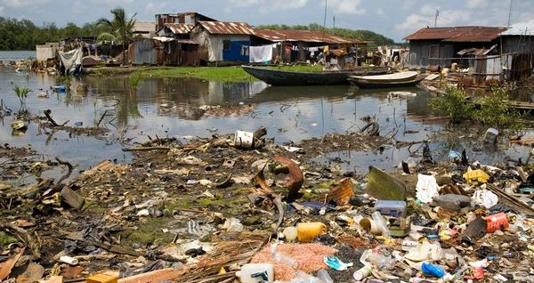
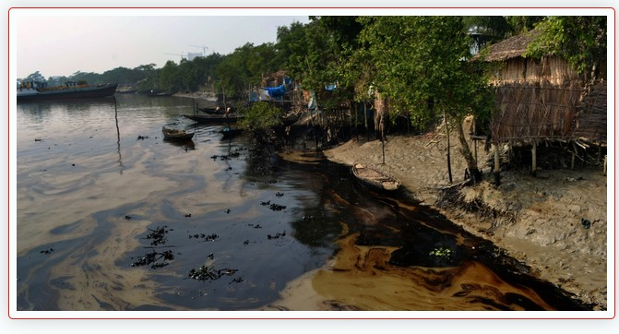
DEGRADED ENVIRONMENT
IMPROPER WASTE DISPOSAL
OIL SPILLAGE
Total Disregard for the Environment

Slide 9
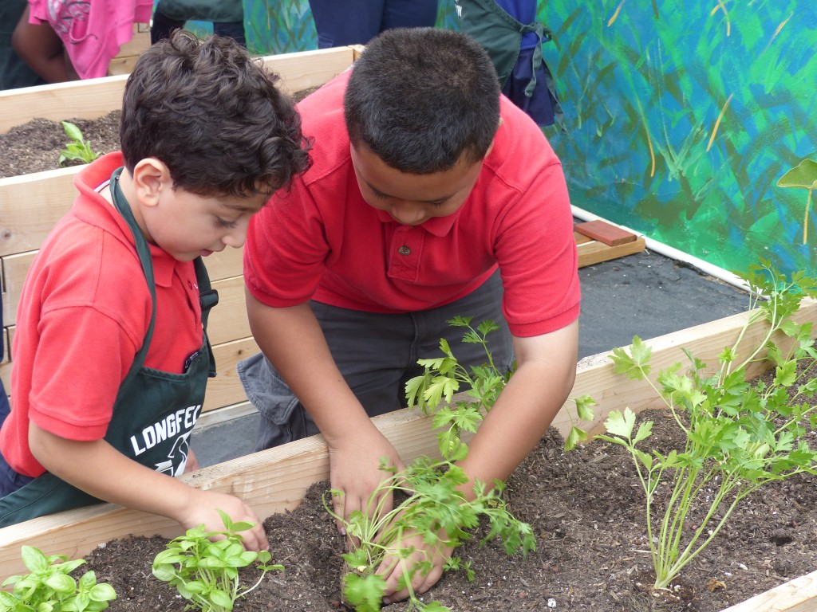
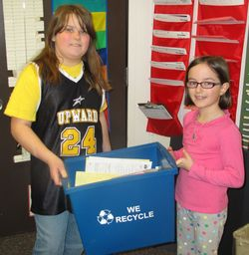
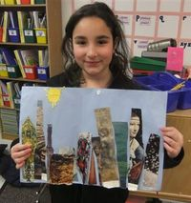
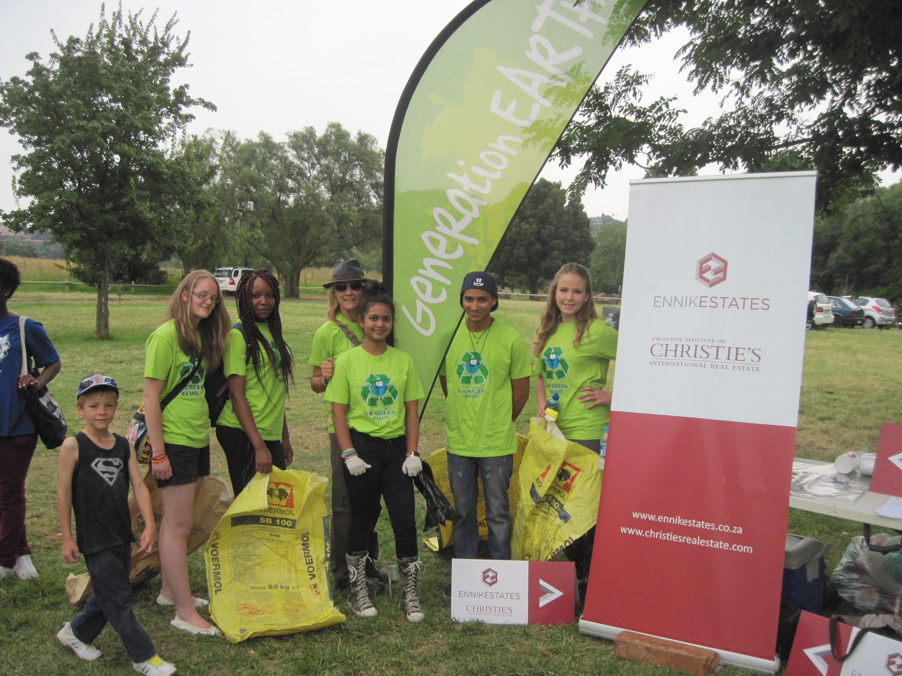
GOING GREEN PROJECTS.
GARDENING
RECYCLING
RECYCLE NEWSPAPERS AND MAGAZINES TO CREATE FABULOUS ART PROJECTS.
CLEAN-UP EXERCISES

Slide 10
FOOD FOR THOUGHTS
We are living on this planet as if we had another one to go to.
- Terri Swearingen
If we pollute our planet, it is WE who will have to live our lives ahead within that polluted environment.
If we deplete the resources on our planet, it is WE who will have to live our lives ahead without these precious resources

Slide 11
FOOD FOR THOUGHTS
So whether you are doing it for yourself or for our future generations, out of a sense of self-love, a sense of responsibility or simply out of love for nature, it is important for every one of us to understand the impact of our human activities on Mother earth.
No matter how small you start, or how insignificant you think your efforts are, you will make a difference.

Slide 12
CONCLUSION.
Change your thoughts and you can change your world.

